Slide 1

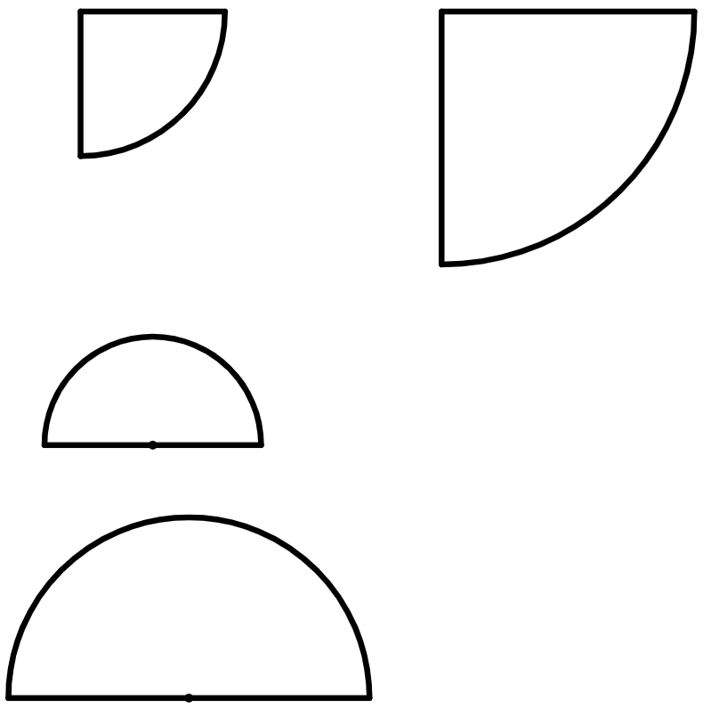
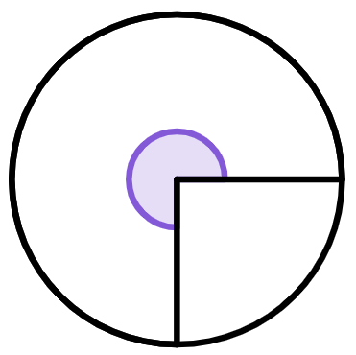
Finding a length in composite shapes
Task A: Finding lengths from areas of circles and sectors
1) Complete the table to find the area of the full circle that the sector comes from.
area of sector | 10π cm² | 25.1 cm² | 31π cm² | 60π cm²
calculation | 10π × 4 | 25.1 × 2
area of full circle | 40π cm²
2) The area of this quarter-circle is 900π cm².
a) Find the area of the full circle that the sector comes from.
b) Using your answer to part a, complete the method to calculate the radius of this quarter-circle.
area of full circle = π × r²
= π × r²
= r²
60 cm = r
3) The area of a semicircle is 39.3 cm².
Complete the method to calculate the diameter of this semicircle.
4) The area of this three-quarter-circle is 1357.2 cm².
What is the radius of the sector?
area of full circle = π × r²
= π × r²
= r²
= r
d
= d

Slide 2
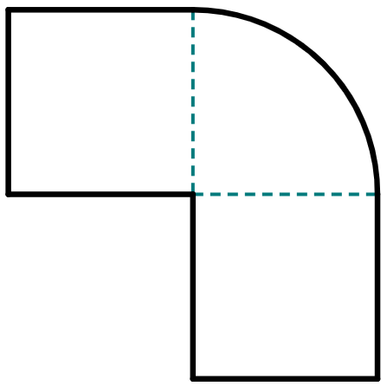

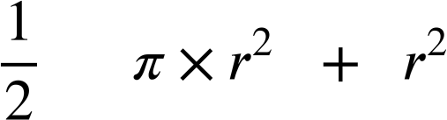
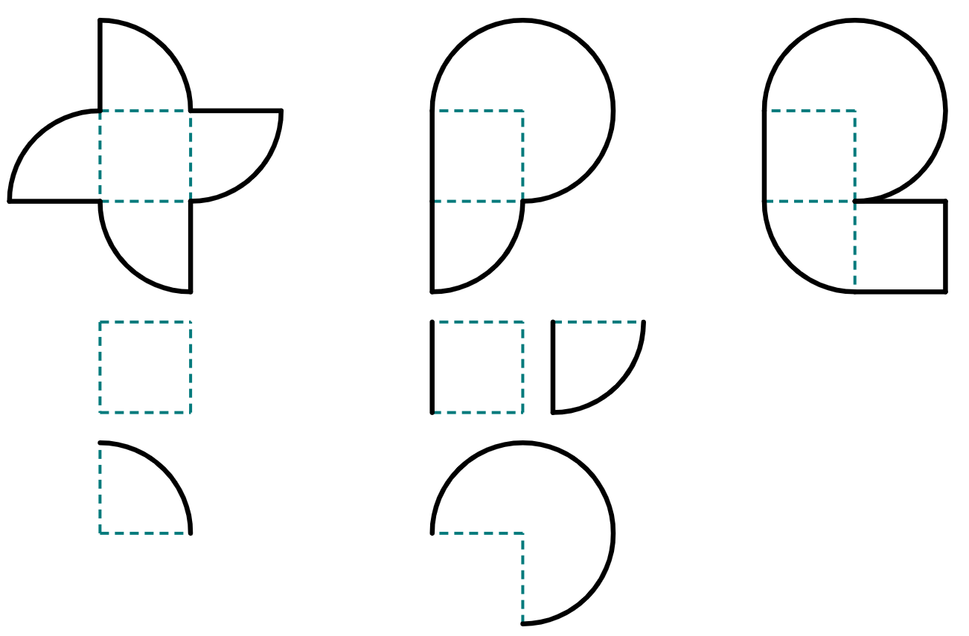
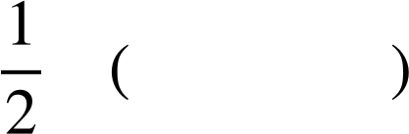
Finding a length in composite shapes
Task B: Finding lengths of composite shapes using algebra
1) This composite shape has an area of 470.7 m².
a) Write down the areas, in terms of r, for the three component parts of this shape.
1
3
area of
1
2
area of
2
r m
area of
3
b) Show by factorising that the area of the composite shape can be written as:
× 2.785…
c) Complete the calculation to find the radius of the quarter-circle, given to the nearest integer.
= 470.7
× 2.785…
2) This composite shape has an area of 11 633.7 mm².
Complete the steps to calculate the value of r, giving your answer to the closest integer.
area:
= 11633.7
circle
square
r mm
factorise:
= 11633.7
convert π expression into decimal:
= 11633.7
divide:
=
square root:
≈
3) This composite shape has an area of 4031 cm².
Find the value of r, giving your answer to the closest integer.
r cm
Mathematics in Education and Industry.
v2.3

